Slide 1

Tittle 1 -
Tittle 2

Slide 2

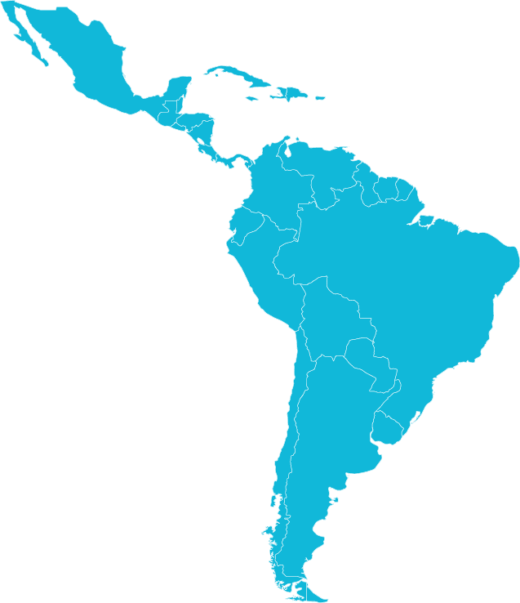
Our history
Founded in 1997, TECWISE works in close collaboration with its customer base on the design, implementation, and support of communication and technology integration solutions, always focused on performance and designed to enhance efficiency, safety, and productivity.
Since 2013, TECWISE has been part of the Comms International group, serving as its base for LATAM and committed to achieving operational results together with our clients.
Vale do Aço
Belo Horizonte
Parauapebas
Vitória
Petrolina
Santiago (Chile)
Geoenvironmental
Digitalization
and IIoT
Telecom

Slide 3








Our Values
Innovate
transforming ideas into solutions, through the relentless pursuit of new technologies that generate value for everyone involved.
Honesty and Transparency
are fundamental principles for a fair and lasting relationship with employees, clients, and partners.
Respect
is putting yourself in someone else’s shoes, understanding boundaries, and fostering harmonious coexistence.
Quality Standard
means knowing that our company works with world-class manufacturers and clients, and we don’t deliver anything below that standard.
Commitment
is identifying with the company's values, which is key to business success..
Value Life
means promoting quality of life, prioritizing health, safety, and well-being for everyone.
Purpose
Technology-driven innovation focused on results.
Vision
To have a local presence in key Latin American countries, in the Mining and Metals segment, in a self-sustaining way.

Slide 4
Contextualization
If more content is needed, just duplicate this slide!

Slide 5
